Slide 1
React Meetup Hamburg | October 2019 | @nilshartmann
NILS HARTMANN
https://nilshartmann.net
One Year
React Hooks
A (Critical) Review
Slides: https://nils.buzz/react-meetup-hooks

Slide 2

https://nilshartmann.net
NILS HARTMANN
nils@nilshartmann.net
Developer, Architect, Trainer from Hamburg (Freelancer)
JavaScript, TypeScript
React
GraphQL
Java
Trainings, Workshops and Coachings
2nd edition out in dec!

Slide 3
React Hooks
Anyone NOT knowing what React Hooks are?

Slide 4
React Hooks
Anyone NOT knowing what React Hooks are?
(My assumption: almost noone)

Slide 5
React Hooks
Anyone NOT knowing what React Hooks are?
Hooks 2 Minute intro
add State, Lifecycle, Sideffects in functional components (almost no need for class components anylonger)

Slide 6
React Hooks
Anyone NOT knowing what React Hooks are?
Hooks 2 Minute intro
add State, Lifecycle, Sideffects in functional components (almost no need for class components anylonger)
"Hooks into your components lifecycle"

Slide 7
React Hooks
Anyone NOT knowing what React Hooks are?
Hooks 2 Minute intro
add State, Lifecycle, Sideffects in functional components (almost no need for class components anylonger)
"Hooks into your components lifecycle"
Regular JavaScript functions...
...but must start with 'use'
...but must not be used in conditionals, for/loops, Class components
...but behaviour is tied to React

Slide 8
React Hooks
Hooks example
import React, { useState } from "react";
export default function SettingsForm(props) {
const [favColor, setFavColor] = useState("blue");
return <•••>
<input value={favColor}
onChange={e => setFavColor(e.target.value) } />
<•••>
}
useState returns value and setter-function
When state changes, component re-renders
component function will run again

Slide 9
One Year
React Hooks
Notes:
Bevor wir uns mit React beschäftigen, ein kurzer Hintergrund zum Thema Single-Page-Anwendungen.

Slide 10
React Hooks
One Year of Hooks...
There are some built-in Hooks, like
useState
useReducer handle state in a Redux-like way but only for one component
useEffect for sideeffects (replaces lifecycle methods in classes)
useContext to receive a Context object
useCallback/useMemo/useRef: solve problems that arise due to using... Hooks

Slide 11
React Hooks
One Year of Hooks...
Libraries ship with Hooks, like
Redux (useSelector, useDispatch, useStore)
Router (useHistory, useParams, useLocation)
Apollo Client (useQuery, useMutation)
React Intl (useIntl)
React i18n (useTranslation)

Slide 12
React Hooks
One Year of Hooks...
Libraries ship with Hooks, like
Redux (useSelector, useDispatch, useStore)
Router (useHistory, useParams, useLocation)
Apollo Client (useQuery, useMutation)
React Intl (useIntl)
React i18n (useTranslation)
Community has them too,
https://usehooks.com
https://nikgraf.github.io/react-hooks/
https://www.hooks.guide/

Slide 13
React Hooks
One Year of Hooks...
...it seems, Hooks are the new way to go for React Apps
(Vue has them now, too btw)

Slide 14
But...
React Hooks
Good or Evil?
Notes:
Bevor wir uns mit React beschäftigen, ein kurzer Hintergrund zum Thema Single-Page-Anwendungen.

Slide 15
Good or Evil?
Who likes Hooks?

Slide 16
Good or Evil?
Who likes Hooks?
(My assumption: almost everyone)

Slide 17
Good or Evil?
Who likes Hooks?
(My assumption: almost everyone)
Who dislikes Hooks?

Slide 18
Good or Evil?
Who likes Hooks?
(My assumption: almost everyone)
Who dislikes Hooks?
(My assumption: almost noone)

Slide 19
Good or Evil?
Let's hear some more...

Slide 20
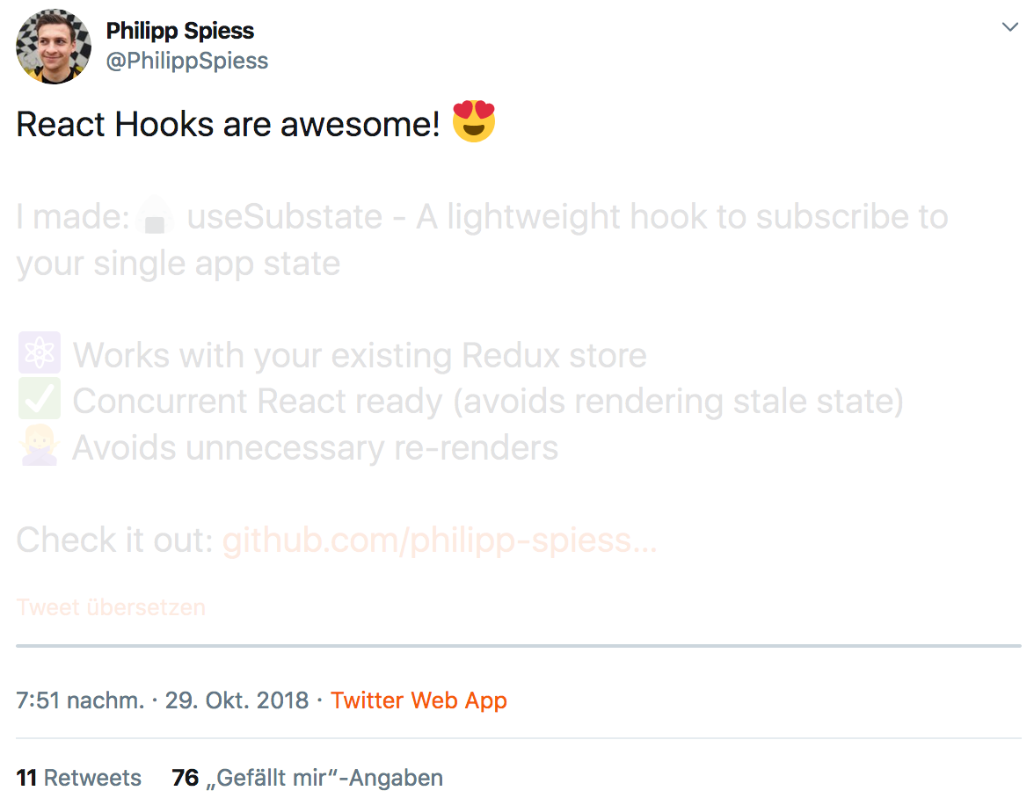
https://twitter.com/philippspiess/status/1056981916489015296
Notes:
Bevor wir uns mit React beschäftigen, ein kurzer Hintergrund zum Thema Single-Page-Anwendungen.

Slide 21
😱
"With Hooks,
React loses its innocence
and becomes Angular"
Attendee of one of my workshops
Notes:
Bevor wir uns mit React beschäftigen, ein kurzer Hintergrund zum Thema Single-Page-Anwendungen.

Slide 22

https://twitter.com/dan_abramov/status/1056808552180793344
Notes:
Bevor wir uns mit React beschäftigen, ein kurzer Hintergrund zum Thema Single-Page-Anwendungen.

Slide 23
😵
"Unsure..."
Me
Notes:
Bevor wir uns mit React beschäftigen, ein kurzer Hintergrund zum Thema Single-Page-Anwendungen.

Slide 24
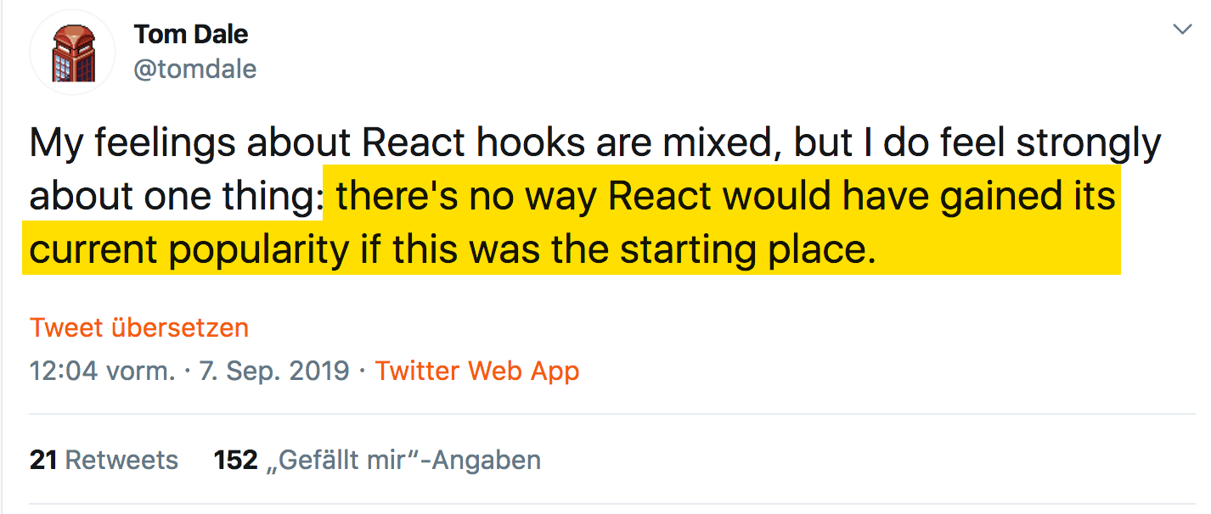
So... How about this?
https://twitter.com/tomdale/status/1170095532066430977
Notes:
Bevor wir uns mit React beschäftigen, ein kurzer Hintergrund zum Thema Single-Page-Anwendungen.

Slide 25
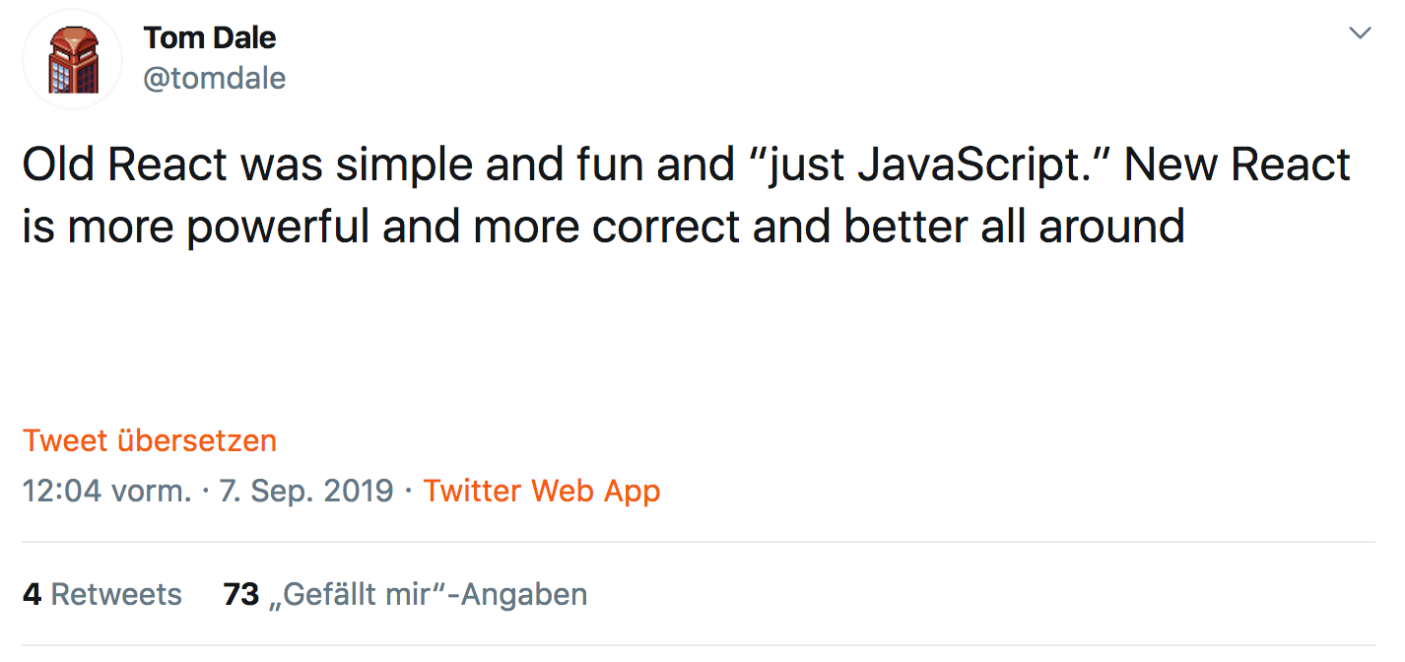
So... How about this?
https://twitter.com/tomdale/status/1170095532922064901
Notes:
Bevor wir uns mit React beschäftigen, ein kurzer Hintergrund zum Thema Single-Page-Anwendungen.

Slide 26
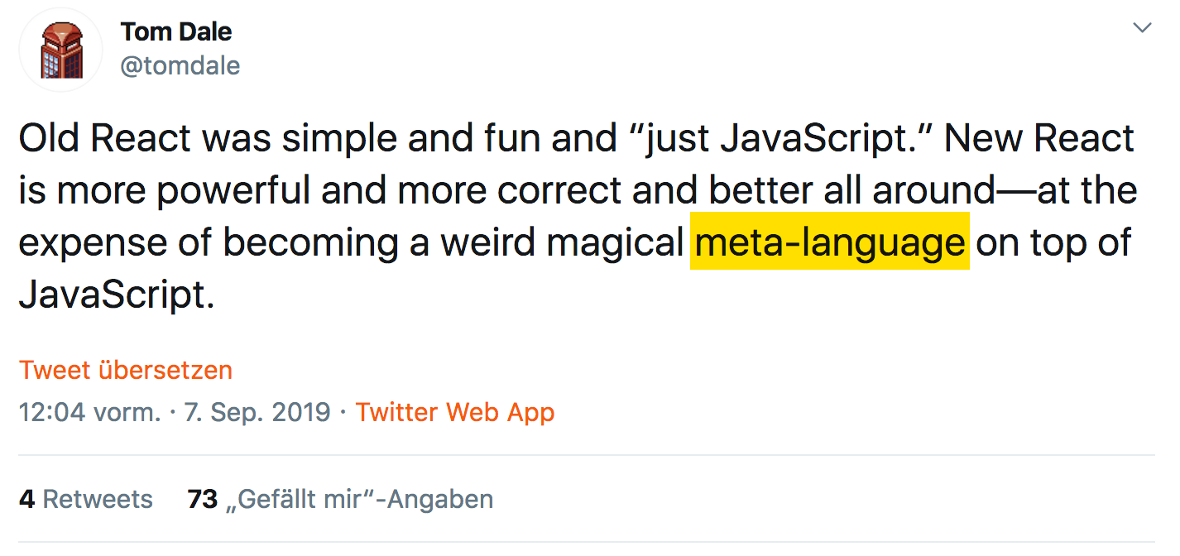
So... How about this?
https://twitter.com/tomdale/status/1170095532922064901
Notes:
Bevor wir uns mit React beschäftigen, ein kurzer Hintergrund zum Thema Single-Page-Anwendungen.

Slide 27
React Hooks
A LOOK AT THE API
Notes:
Bevor wir uns mit React beschäftigen, ein kurzer Hintergrund zum Thema Single-Page-Anwendungen.

Slide 28
A look at the api
useContext to access React Context in your functional component
export default function SettingsForm(props) {
const contextValue = React.useContext(ThemeContext);
return <p>Your context color: {contextValue.color}</p>
}

Slide 29
A look at the api
useContext to access React Context in your functional component
export default function SettingsForm(props) {
const contextValue = React.useContext(ThemeContext);
return <p>Your context color: {contextValue.color}</p>
}
Noteable: This is probably easy to understand: I want to use context "ThemeContext" here in my component

Slide 30
A look at the api
useContext to access React Context in your functional component
export default function SettingsForm(props) {
const contextValue = React.useContext(ThemeContext);
return <p>Your context color: {contextValue.color}</p>
}
Noteable: This is probably easy to understand: I want to use context "ThemeContext" here in my component
But: if context changes, SettingsForm will automatically be re-executed! Why? Because it's a ... Hook ("weird magical meta-language") "Something" happens in the background to make that work There is no indicator that this will happen. Syntactically "only" JavaScript

Slide 31
A look at the api
useState for local State in your functional component
export default function SettingsForm(props) {
const [ favColor, setFavColor ] = useState("red");
return <input value={favColor}
onChange={e => setFavColor(e.target.value) />
}

Slide 32
A look at the api
useState for local State in your functional component
export default function SettingsForm(props) {
const [ favColor, setFavColor ] = React.seState("red");
return <input value={favColor}
onChange={e => setFavColor(e.target.value) />
}
Noteable: Return Value
what is this? Tuple! (btw: I think Tuples will make it to JavaScript)
unsual (yet), but elegant, allows to name my variables as I want them to

Slide 33
A look at the api
useState for local State in your functional component
export default function SettingsForm(props) {
const [ favColor, setFavColor ] = React.useState("red");
return <input value={favColor}
onChange={e => setFavColor(e.target.value) />
}
Noteable: Return Value
what is this? Tuple! (btw: I think Tuples will make it to JavaScript)
unsual (yet), but elegant, allows to name my variables as I want them to
Noteable: initial value, used only once even if this function is run on each render Why? Because it's a ... Hook ("weird magical meta-language")

Slide 34
A look at the api
useState for local State in your functional component
export default function SettingsForm(props) {
const [ favColor, setFavColor ] = React.useState("red");
return <input value={favColor}
onChange={e => setFavColor(e.target.value) />
}
Noteable: Return Value
what is this? Tuple! (btw: I think Tuples will make it to JavaScript)
unsual (yet), but elegant, allows to name my variables as I want them to
Noteable: initial value, used only once even if this method is run on each render Why? Because it's a ... Hook ("weird magical meta-language")
Noteable: setter-Function leads to re-render Why? Because it's a ... Hook ("weird magical meta-language")

Slide 35
A look at the api
A timer...
export default function App() {
const [running, setRunning] = useState(false);
useEffect(() => {
const id = setTimeout(() => setRunning(false), 2000);
setRunning(true);
return () => clearTimeout(id);
}, []);
return <button onClick={cancel}>Running: {running.toString()}</button>;
}

Slide 36
A look at the api
useRef: for fixing problems introduced by Hooks
We want to cancel the running timeout
Somehow need to get access to the cleanup function or the id
export default function App() {
const [running, setRunning] = useState(false);
function cancel() { 🤔 }
useEffect(() => {
const id = setTimeout(() => setRunning(false), 2000);
setRunning(true);
return () => clearTimeout(id);
}, []);
return <button onClick={cancel}>Running: {running.toString()}</button>;
}

Slide 37
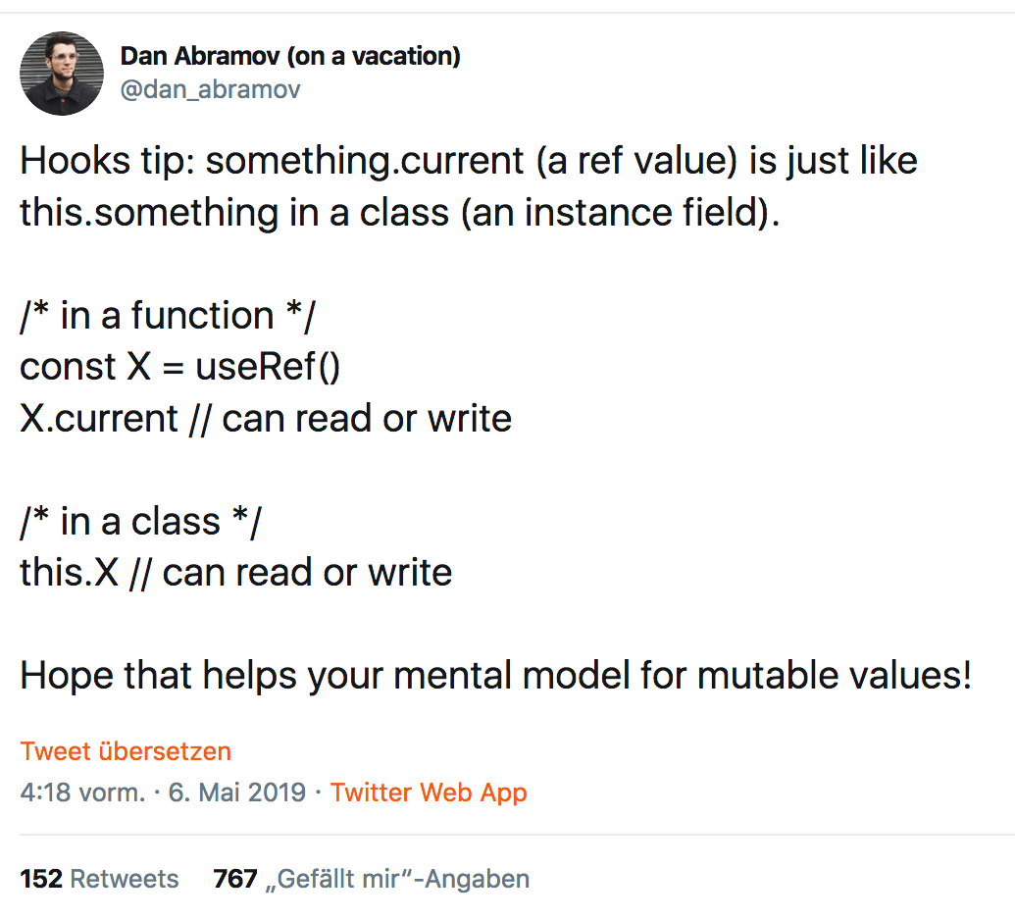
A look at the api
useRef: Remember Class Components?
"weird magical meta-language"
JavaScript Standard
https://twitter.com/dan_abramov/status/1125223181701263360

Slide 38
A look at the api
useRef: for fixing problems introduced by Hooks
We want to cancel the running timeout
Somehow need to get access to the cleanup function or the id
export default function App() {
const [running, setRunning] = useState(false);
const timerRef = useRef();
function cancel() { clearTimeout(timerRef.current); }
useEffect(() => {
const id = setTimeout(() => setRunning(false), 2000);
timerRef.current = id;
setRunning(true);
return () => clearTimeout(id);
}, []);
return <button onClick={cancel}>Running: {running.toString()}</button>;
}

Slide 39
How does it Look to use Hooks?
USING HOOKS
Notes:
Bevor wir uns mit React beschäftigen, ein kurzer Hintergrund zum Thema Single-Page-Anwendungen.

Slide 40
Using hooks
Using Hooks: this is simple...
import React, { useState } from "react";
export default function SettingsForm(props) {
const [ favColor, setFavColor ] = useState("blue");
return <input value={favColor} onChange={...} />
}

Slide 41
using hooks
Using Hooks: let's add context...
import React, { useState, useContext } from "react";
export default function SettingsForm(props) {
const login = useContext(LoginContext);
const [ favColor, setFavColor ] = useState("blue");
return <input value={favColor} onChange={...} />
}

Slide 42
using hooks
Using Hooks: and now... boom!
import React, { useState, useContext } from "react";
export default function SettingsForm(props) {
const login = useContext(LoginContext);
if (!login.loggedIn) {
return <Redirect to="/login" />
}
const [ favColor, setFavColor ] = useState("blue");
return <input value={favColor} onChange={...} />
}
😱
Why? Because it's a ... Hook ("weird magical meta-language") Hooks must always be called in the same order

Slide 43
using hooks
...and another one: useHistory from React Router
import { useHistory } from "react-router-dom";
export default function SettingsForm(props) {
function saveAndRedirect() {
saveSettings().then(
() => useHistory().push("/home")
);
}
return <•••><button onClick={saveAndRedirect}>Save</button><•••>
}
"weird magical meta-language"
😱

Slide 44
using hooks
...this works
import { useHistory } from "react-router-dom";
export default function SettingsForm(props) {
const history = useHistory();
function saveAndRedirect() {
saveSettings().then(
() => history.push("/home")
);
}
return <•••><button onClick={saveAndRedirect}>Save</button><•••>
}
Might not be big difference, but...
☺️

Slide 45
using hooks
Might not be a big difference, but...
you have to know where you can use Hooks
forces you to structure your code in exactly this way
it's not "standard javascript"
we even have/need a linter for Rules of Hooks

Slide 46
using hooks
Might not be a big difference, but...
you have to know where you can use Hooks
forces you to structure your code in exactly this way
it's not "standard javascript"
we even have/need a linter for Rules of Hooks
Do you remember why React doesn't add a template language?

Slide 47
using hooks
Might not be a big difference, but...
you have to know where you can use Hooks
forces you to structure your code in exactly this way
it's not "standard javascript"
we even have/need a linter for Rules of Hooks
Do you remember why React doesn't add a template language?
To enable us to use our "favorite" language: JavaScript
no need to learn a new language...

Slide 48
using hooks
Might not be a big difference, but...
you have to know where you can use Hooks
forces you to structure your code in exactly this way
it's not "standard javascript"
we even have/need a linter for Rules of Hooks
Do you remember why React doesn't add a template language?
To enable us to use our "favorite" language: JavaScript
no need to learn a new language...
Does that mean Hooks (or React) are evil?
No, but... they have their "price" (as classes have)
It's "rethinking" again

Slide 49
of using Hooks
Consequences
Notes:
Bevor wir uns mit React beschäftigen, ein kurzer Hintergrund zum Thema Single-Page-Anwendungen.

Slide 50
Consequences
Can Custom Hooks replace existing patterns?
Custom Hooks are another way for reusable logic
Replacement for HOCs?
Replacement for Render Properties?
But...

Slide 51
Consequences
Example: "old" React Router (with render prop)
// App.js
<Route path="/settings/:id"
render={({match}) => <SettingsForm settingsId={match.params.id} />

Slide 52
Consequences
Example: "old" React Router (with render prop)
// App.js
<Route path="/settings/:id"
render={({match}) => <SettingsForm settingsId={match.params.id} />
// SettingsForm.js
export default function SettingsForm( {settingsId} ) {
// do something with settingsId
return •••;
}
Noteable:
SettingsForm does not know anything about Router
Routing "Logic" (Params, Routes, ...) are at one place (good imho)

Slide 53
Consequences
Example: React Router with new Route API and useParams
// App.js
<Route path="/settings/:id"><SettingsForm /></Route>
new Router
5.2 API
no render prop anymore!

Slide 54
Consequences
Example: React Router with new Route API and useParams
// App.js
<Route path="/settings/:id"><SettingsForm /></Route>
// SettingsForm.js
import { useParams } from "react-router-dom";
export default function SettingsForm( ) {
const { settingsId } = useParams();
// do something with settingsId
return •••;
}
Noteable:
SettingsForm knows about Router API and Routing "Logic" (which Params)
What about "Colocation"?
new Router
5.2 API
no render-Prop anymore
(credits: https://twitter.com/andrewgreenh/status/1177213442710745091?s=20)

Slide 55
Consequences
What about this one? (from: https://twitter.com/Wolverineks/status/1177818104048472065)
function RouterContext({ children }) {
return children({
history: useHistory(),
params: useParams(),
...
});
}

Slide 56

Consequences
What about this one? (from: https://twitter.com/Wolverineks/status/1177818104048472065)
function RouterContext({ children }) {
return children({
history: useHistory(),
params: useParams(),
...
});
}
<Route path="/settings/:id">
<RouterContext>
{({ params }) => <SettingsForm settingsId={params.id} />
</RouterContext>
</Router>
Noteable: welcome back, render properties!
But at least SettingsForm is Router-free

Slide 57
Consequences
Example: Redux useDispatch and useSelector instead of connect
import { useDispatch, useSelector } from "react-redux";
export default function SettingsForm(props) {
const favColor = useSelector(state => state.theme.favColor);
const dispatch = useDispatch();
const setNewColor = (r,g,b) => dispatch(actions.setNewColor(r,g,b));
return <•••><ColorPicker onSet={setNewColor}/><•••>
}

Slide 58
Consequences
Example: Redux useDispatch and useSelector instead of connect
import { useDispatch, useSelector } from "react-redux";
export default function SettingsForm(props) {
const favColor = useSelector(state => state.theme.favColor);
const dispatch = useDispatch();
const setNewColor = (r,g,b) => dispatch(actions.setNewColor(r,g,b));
return <•••><ColorPicker onSet={setNewColor}/><•••>
}
Consequences:
We now have only one component, have seen that already
the component is bound to Redux, have seen that already

Slide 59
Consequences
Example: Redux useDispatch and useSelector instead of connect
import { useDispatch, useSelector } from "react-redux";
export default function SettingsForm(props) {
const favColor = useSelector(state => state.theme.favColor);
const dispatch = useDispatch();
const setNewColor = (r,g,b) => dispatch(actions.setNewColor(r,g,b));
return <•••><ColorPicker onSet={setNewColor}/><•••>
}
Consequences:
We now have only one component, have seen that already
the component is bound to Redux, have seen that already
But: it also has different rendering behaviour (compared to connect)
might "force" re-rendering of the ColorPicker component

Slide 60
Consequences
We can fix this:
import { useDispatch, useSelector } from "react-redux";
export default function SettingsForm(props) {
const favColor = useSelector(state => state.theme.favColor);
const dispatch = useDispatch();
const setNewColor = React.useCallback(
(r,g,b) => dispatch(actions.setNewColor(r,g,b)),
[ dispatch ]
);
return <•••><ColorPicker onSet={setNewColor}/><•••>
}

Slide 61
Consequences
We can fix this:
import { useDispatch, useSelector } from "react-redux";
export default function SettingsForm(props) {
const favColor = useSelector(state => state.theme.favColor);
const dispatch = useDispatch();
const setNewColor = React.useCallback(
(r,g,b) => dispatch(actions.setNewColor(r,g,b)),
[ dispatch ]
);
return <•••><ColorPicker onSet={setNewColor}/><•••>
}
"Nice!" (Fortunately we only have one callback function here...)
remember the dependency array? 👋

Slide 62
Consequences
Is this really a problem?
This problem is not related to Redux only
In most cases not as performance might be good enough to re-render all the time, so useCallback (and useMemo) is not a must
But this is – esp. for beginners – not easy to understand (call me a beginner)
BTW: I wonder how many CPU engery is wasted due to billions of unneccessary function executions in React Apps world wide 🤓

Slide 63
One Year
React Hooks
Summary
Notes:
Bevor wir uns mit React beschäftigen, ein kurzer Hintergrund zum Thema Single-Page-Anwendungen.

Slide 64
One Year React Hooks
Summary

Slide 65
One Year React Hooks
Summary
If you're already using React, use Hooks.
They will stay. It's the "New React". Classes will lose their relevance.
For (experienced) React developers they are a good innovation
We will see how Hooks-based architectures evolve

Slide 66
One Year React Hooks
Summary
If you're already using React, use Hooks.
They will stay. It's the "New React". Classes will lose their relevance.
For (experienced) React developers they are a good innovation
We will see how Hooks-based architectures evolve
However:
While technically standard JavaScript functions, their usage is not
They are more like an own "magical meta-language" for React
Selling point "you only have to know JavaScript to learn React" is not valid anymore (if it has ever been)

Slide 67
One Year React Hooks
Summary
If you're already using React, use Hooks.
They will stay. It's the "New React". Classes will lose their relevance.
For (experienced) React developers they are a good innovation
We will see how Hooks-based architectures evolve
However:
While technically standard JavaScript functions, their usage is not
They are more like an own "magical meta-language" for React
Selling point "you only have to know JavaScript to learn React" is not valid anymore (if it has ever been)
For people not familiar with React/new to React
Hooks might scare people
As React becomes a little less "JS Standard", People might consider alternatives, like Web Components (Standard!)
We're still far away from "React Best Practices"

Slide 68
nils@nilshartmann.net
NILS HARTMANN
https://nilshartmann.net
🌻
Thanks a lot!
What do you think?
Slides: https://nils.buzz/react-meetup-hooks

